Slide 1

Comparative Analysis for energy forecasting using LSTM Model on IOT Dataset
Big Data C3 – Final Project Evaluation
Indian Institute of Information Technology, Allahabad
Prayagraj
Presented By:
Abhishek Karmakar (ids2022007)
Sharik Gazi (ids2022009)
Submitted to:
Dr. Sonali Agarwal

Slide 2
Contents
Introduction
About Dataset
Objective
Visualization and Code Implementation
Implementation using ELEPHAS
Conclusion and Future Work

Slide 3
Introduction

Slide 4
Introduction
Energy forecasting for commercial real estate is the process of applying statistics to make predictions about consumption levels and corresponding utility costs in both the short term and long term.
Energy forecasting models take into account Global active power, Global inactive power, voltage, and Global intensity, Submetering1, Submetering2 and Submetering3 to make predictions.
Forecasting can be both expected price value and probabilistic forecasting. Energy forecasting is a technique to predict future energy needs to achieve demand and supply equilibrium.
Here in this project we have created a LSTM model which can predict the future values of all the attributes.

Slide 5
To understand what we actually want to do in this project, a simple remark is that we have to create a predictive analysis using LSTM Model.
Design a comparative analysis for energy forecasting using an IoT data on a weekly basis using Pyspark deep learning libraries to choose the best model and also calculate error metrices using various statistical methods to choose the best model.

Slide 6
About the Dataset

Slide 7
About Dataset – Household Prediction
The dataset can be downloaded from the link given below. https://archive.ics.uci.edu/ml/machine-learning-databases/00235/
The dataset contains the following attributes: Date, Time, Global active power, Global reactive power, Voltage, Global intensity, Sub metering1, Sub metering2, Sub metering3.
This dataset contains 2075259 measurements gathered between December 2006 and November 2010 (47 months).
Notes:
1. (globalactivepower*1000/60 - submetering1 - submetering2 - submetering3) represents the active energy consumed every minute (in watt hour) in the household by electrical equipment not measured in sub-meterings 1, 2 and 3.
2. The dataset contains some missing values in the measurements (nearly 1,25% of the rows). All calendar timestamps are present in the dataset but for some timestamps, the measurement values are missing: a missing value is represented by the absence of value between two consecutive semi-colon attribute separators. For instance, the dataset shows missing values on April 28, 2007.

Slide 8
Objective

Slide 9
OBJECTIVE
The main objective of this report is to implement a LSTM model for the correct predictions of the all the attributes using PySpark.
Well in this report an additional package called as elephas been used to implement the model training. This makes it faster.
The keras and the Spark library has been integrated for training, reason behind there has been no Deep learning packages embedded in the PySpark library.

Slide 10
Visualization and Code Implementation

Slide 11
Visualization and Code Implementation
This project has been implemented in Google Collab. The first thing is that this project the dataset has been hosted in kaggle and the access to download from kaggle has been taken from the local machine called kaggle.json.
The initial libraries that has been installed was PySpark and keras using the command :
!pip install pyspark
!pip install -q kaggle
We have to unzip it and then it becomes ready to use in Google Collab.
If we run this project into our local machine, then we can just upload the file normally using pandas or PySpark library.

Slide 12
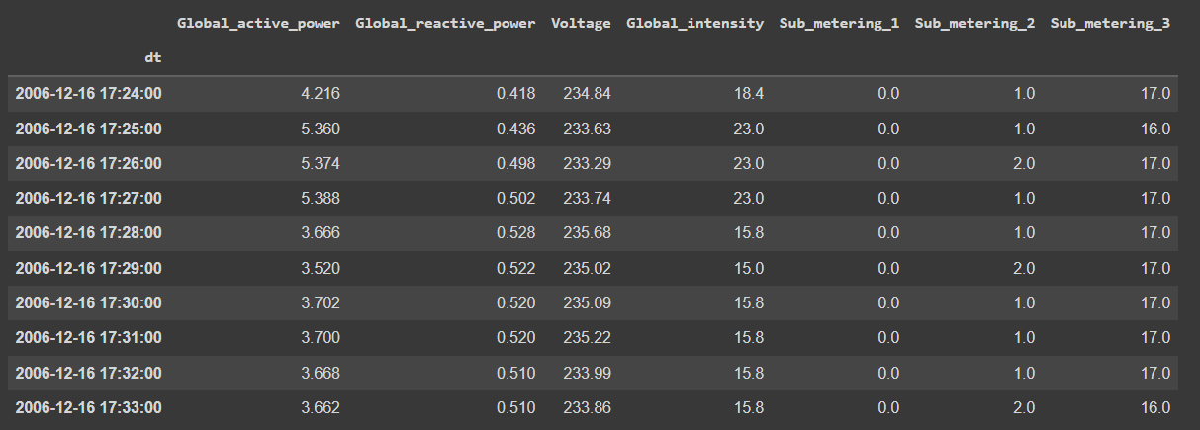
Visualization and Code Implementation
After reading the file, we have converted date and time column as an index.

Slide 13
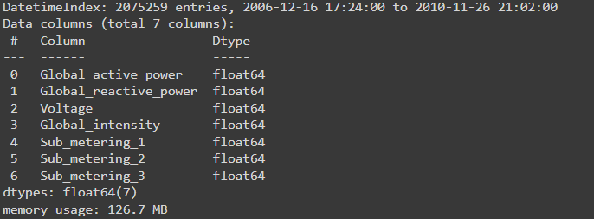
Visualization and Code Implementation
All the samples containing ‘?’ has been converted into NaN. The columns that it contained were all float64 types. This database have 20,75,259 rows and 7 columns.

Slide 14
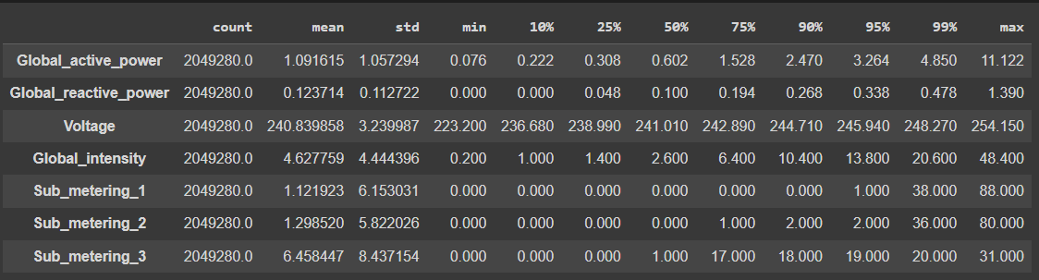
Visualization and Code Implementation
The dataset description is as follows :-

Slide 15
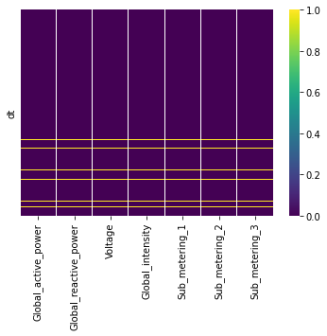
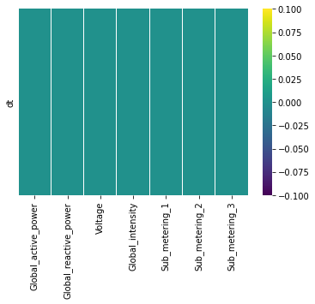
Data Cleaning
NaN after replacing with mean value of the columns
Data containing NULL

Slide 16
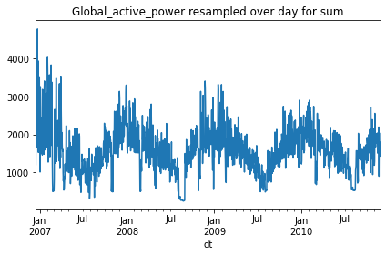
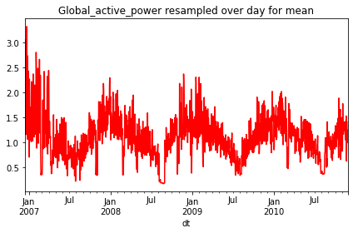
Re-sampling Data
Plotting the "just data" has very high granularity. Therefore we have re-sampled the data to make it convenient.
Below we resample over day, and show the sum and mean of Global active power. It is seen that mean and sum of resampled data set, have similar structure.

Slide 17
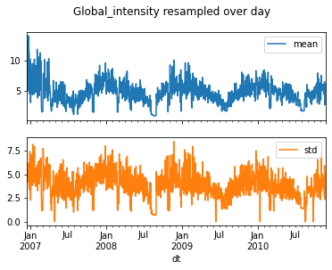
Re-Sampling Data
mean and standard deviation of 'Global Intensity' resampled over day

Slide 18
Re-Sampling Data
mean and standard deviation of 'Global Intensity' resampled over day

Slide 19
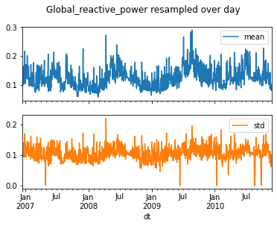
Re-Sampling Data
mean and standard Deviation of 'Global reactive power' resampled over day.

Slide 20
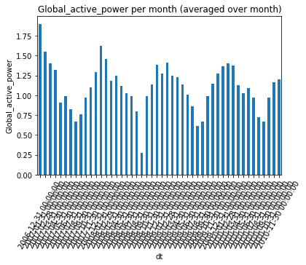
Re-Sampling Data
Mean of 'Global active power' resampled over month

Slide 21
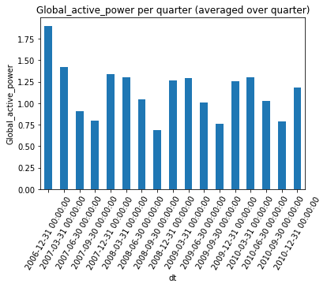
Re-Sampling Data
Mean of 'Global active power' resampled over Quarter
It is very important to note from the following plots that resampling over
larger time interval, will diminish the
periodicity of system as we expect. This
is important for machine learning in feature engineering

Slide 22
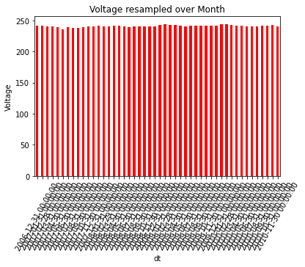
Re-Sampling Data
Voltage resamples over month

Slide 23
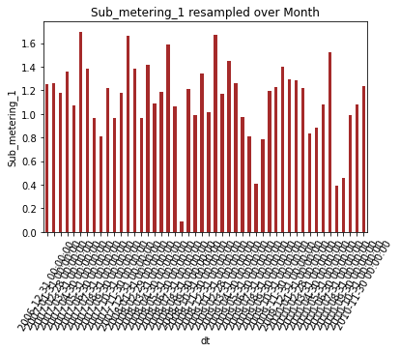
Re-Sampling Data
Mean of ‘Sub Metering1' resampled over month

Slide 24
It is seen from the previous plots that
the mean of 'Voltage' over month is
pretty much constant compared to
other features. This is important again
in feature selection

Slide 25
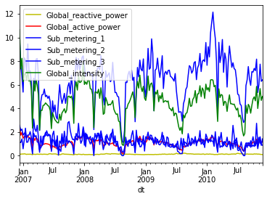
Re-Sampling Data
Resampling over week by computing mean

Slide 26
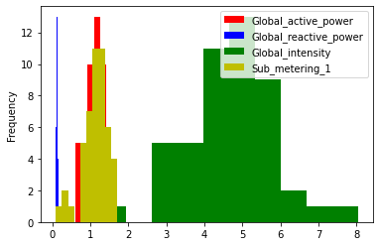
Re-Sampling Data
Below I show histogram plot of the mean of different feature resampled over month

Slide 27
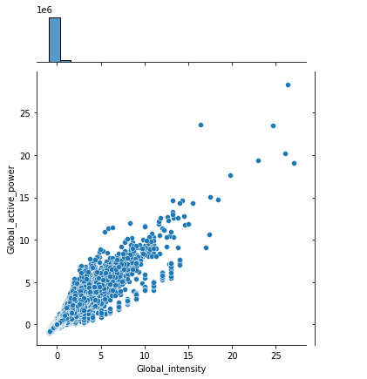
Re-Sampling Data
The correlations between 'Global intensity', 'Global active power‘ is highly correlated.

Slide 28
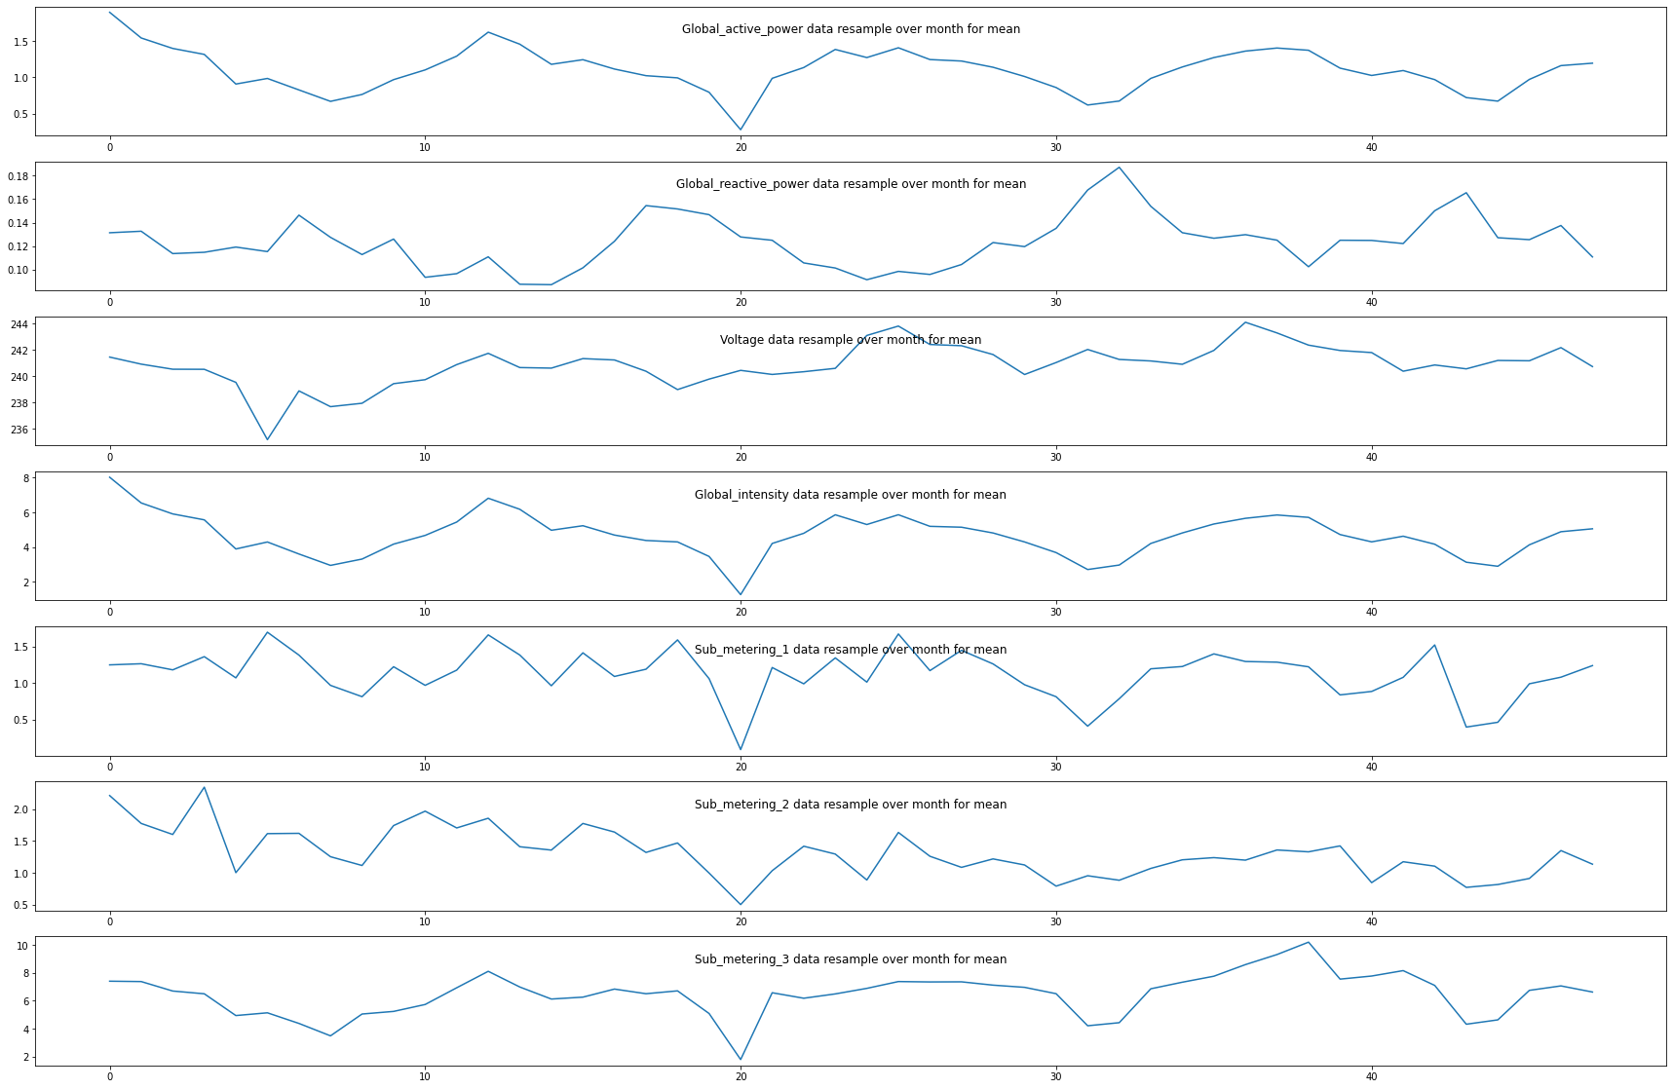
Month-wise Resampling

Slide 29
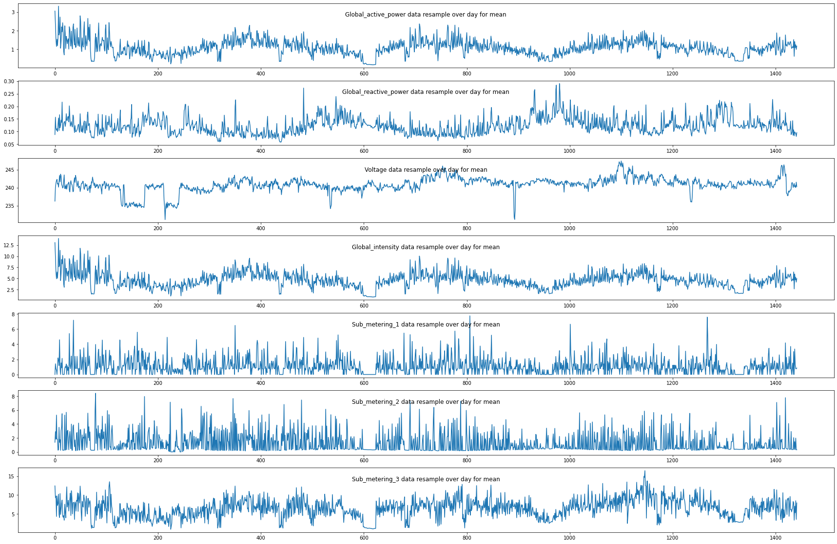
Day-wise Resampling

Slide 30
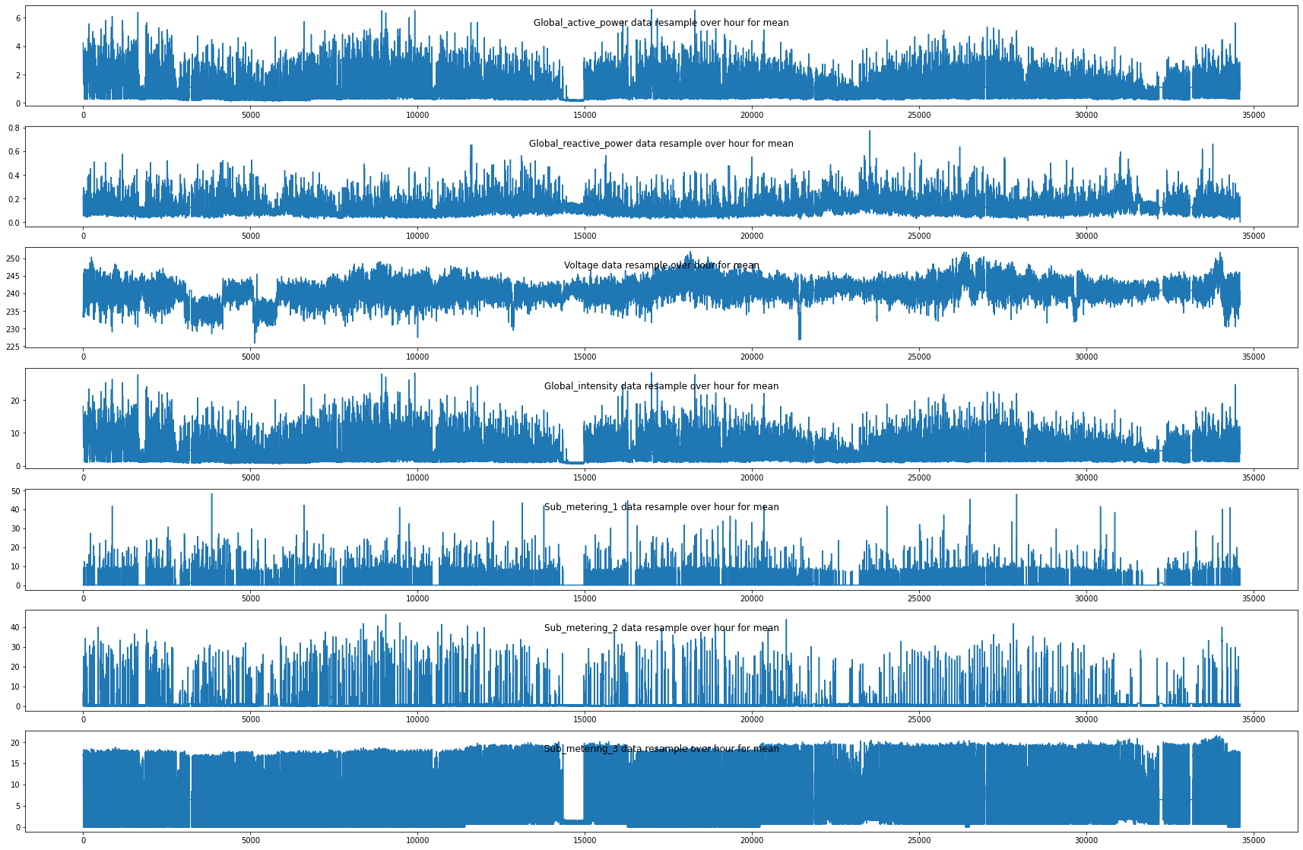
Hour-Wise Resampling

Slide 31
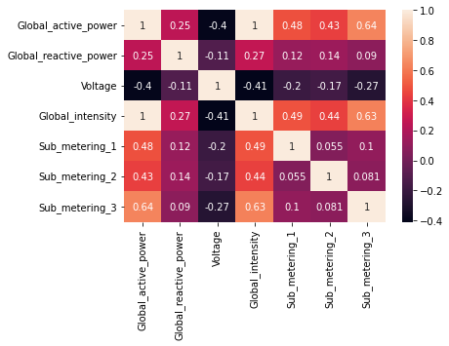
Correlation Matrix

Slide 32
Correlations
If processing all the original data, the runtime will be very costly, but if processing data with large time-scale samples (e.g. monthly), it will affect the model's productivity.
From Correlation Matrix, it is seen that 'Global Intensity' and 'Global active power' correlated. But 'Voltage', 'Global active power' are less correlated.

Slide 33
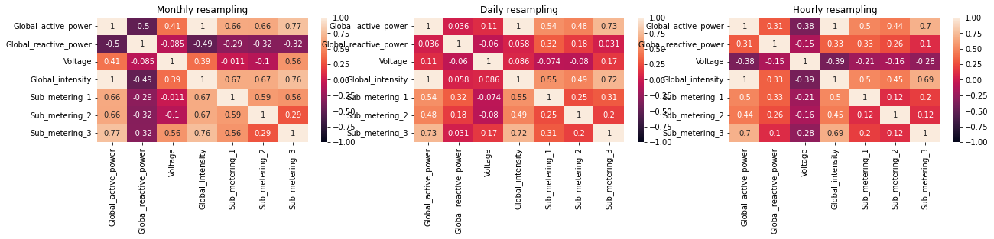
Correlations based on Month, Hour and Day wise sampling
It is seen from above that with resampling techniques
one can change the correlations among features

Slide 34
LSTM Model Data Preparation and Fitting – Global Active Power

Slide 35
LSTM Model Data Preparation and fitting
The LSTM neural network has been selected because:
It is best suited for large data, time-series, and sequential problem.
In the first step, we will frame the problem to predict the Global active power.

Slide 36
LSTM Model Data Preparation and fitting
Outliers Removal:-
There is many ways of removing outliers out of which we are selecting the Inter Quartile Range for detecting and removing the outliers.
Find the first quartile, Q1.
Find the third quartile, Q3.
Calculate the IQR. IQR= Q3-Q1.
Define the normal data range with lower limit as Q1–1.5*IQR and upper limit as Q3+1.5*IQR.
Any data point outside this range is considered as outlier and should be removed for further analysis.

Slide 37
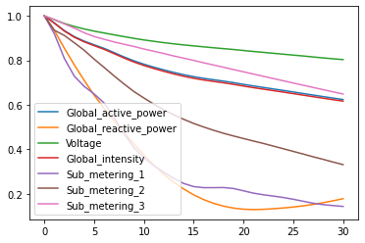
LSTM Model Data Preparation and fitting
Outliers Removal:-
To fill in missing values, first check for linearity in each column using autocorrelation plots. Autocorrelation of different signals change with lag to better model the imputation.
For outliers, a linear interpolation with a limit of 5
to fill in missing values using autocorrelation plot
has been used better modelling purpose but
unfortunately it didn’t help much so we dropped
the idea.
The way of proceeding with the NaN values in the
dataset is replacing with mean values.

Slide 38
LSTM Model Data Preparation – Global Active Power
In order to reduce the computation time, and also get a quick result to test the model. We have resampled the data over hour to reduce the size of data from 2075259 to 34589 (data are given in hours).
No. of rows = 34589
No. of columns = 7
So, we will have 7 input series variables and the 1 output variable for 'Global active power' at the current time in hour.
We also splitting the data into: train and validation sets. Let's select 30000 data over 34,589 data to train, the rest will be used to test the model.

Slide 39
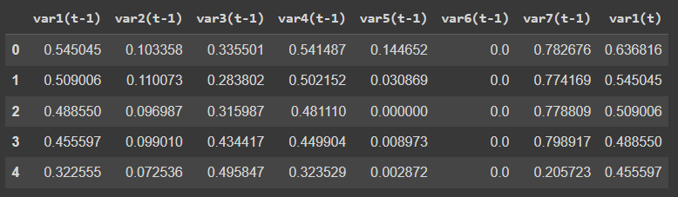
LSTM Model Data Preparation
We did a min-max normalization and the reframed the dataset.
We will frame the supervised learning problem as predicting the Global active power at the current time (t)
Given the Global active power measurement and other features at the prior time step.

Slide 40
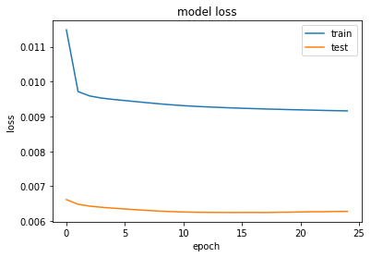
LSTM Model Data Preparation – Global Active Power
For global active power, LSTM model looks like:-
100 neurons in the first visible layer
30 neuron for Dense Layer and then 1 neuron in the output layer for predicting Global active power
The input shape will be 1 time step with 7 features
The mean squared error loss function and the efficient adam version of stochastic gradient descent
The model will be fit for 25 training epochs with a batch size of 70.
In the final Output the training loss comes to be 0.92% and testing loss comes out to be 0.63%
Mean Absolute Error: 0.376
Mean Squared Error: 0.260
Test RMSE: 0.510

Slide 41
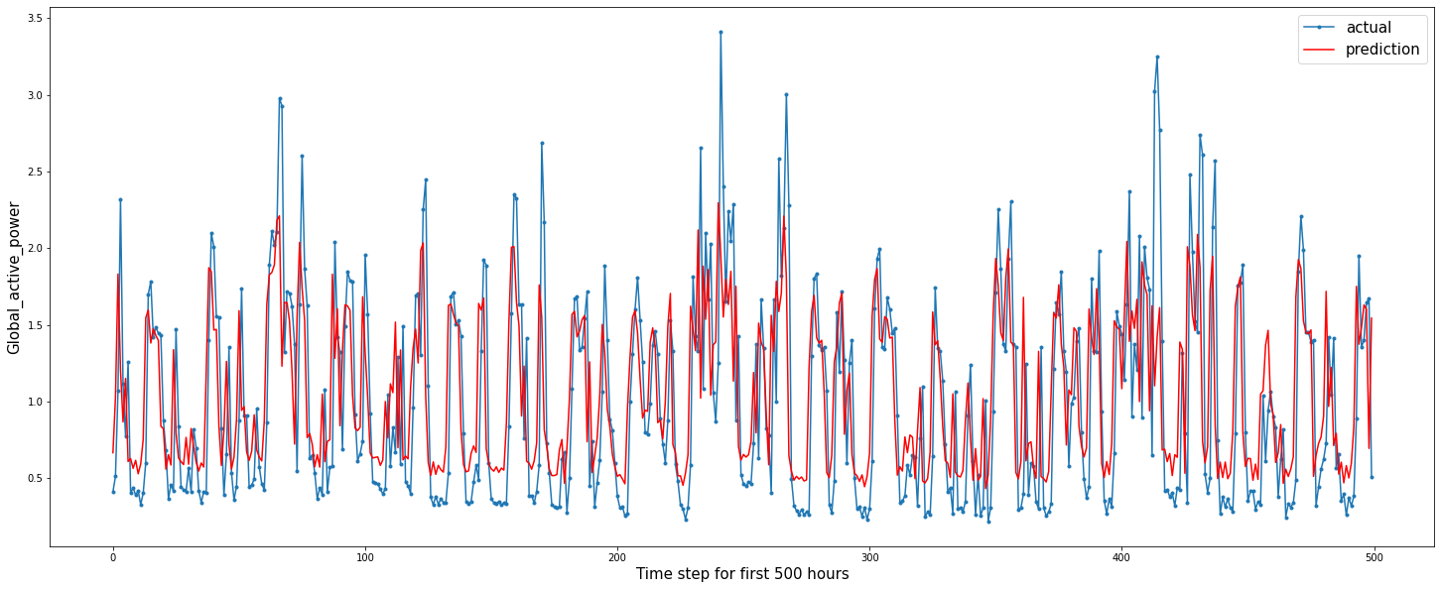
LSTM Model Data Preparation – Global Active Power
First 500 data prediction

Slide 42
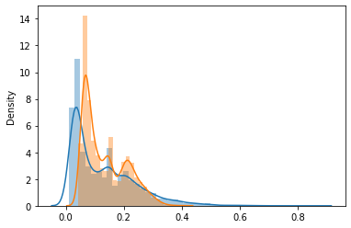
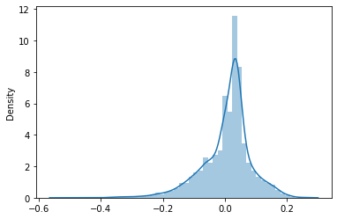
LSTM Model Data Preparation – Global Active Power
Actual and Predicted Distribution Distplot of difference of actual and predicted value
Difference of Variance = 0.00641547690078989

Slide 43
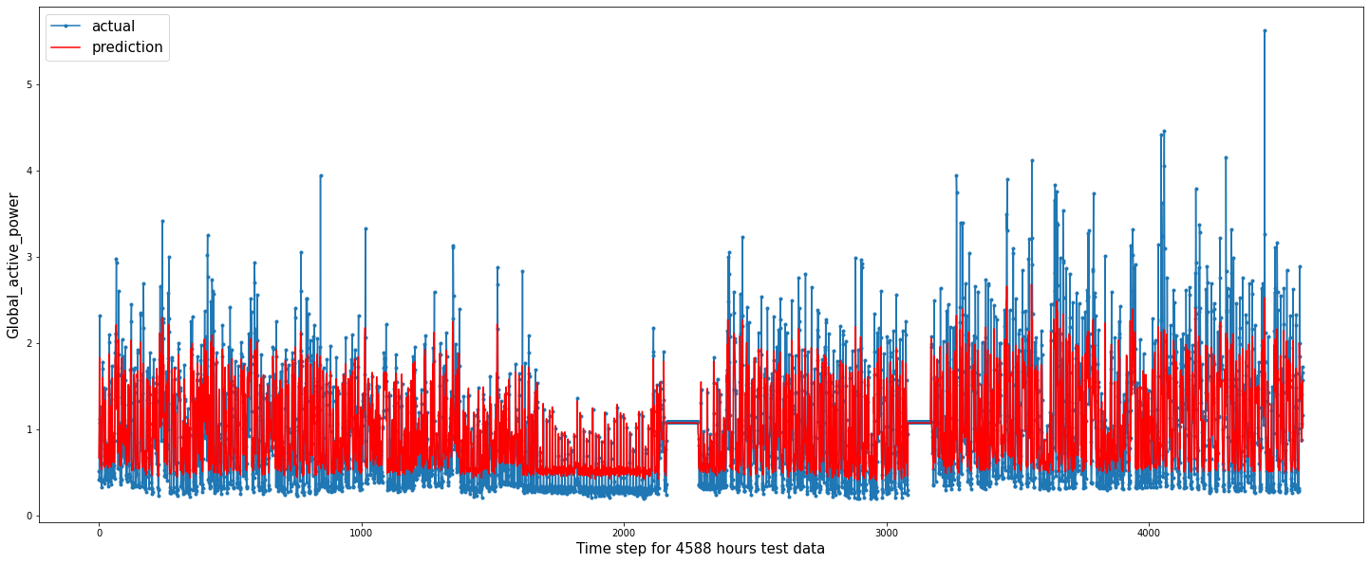
LSTM Model Data Preparation – Global Active Power
Prediction of Test Data

Slide 44
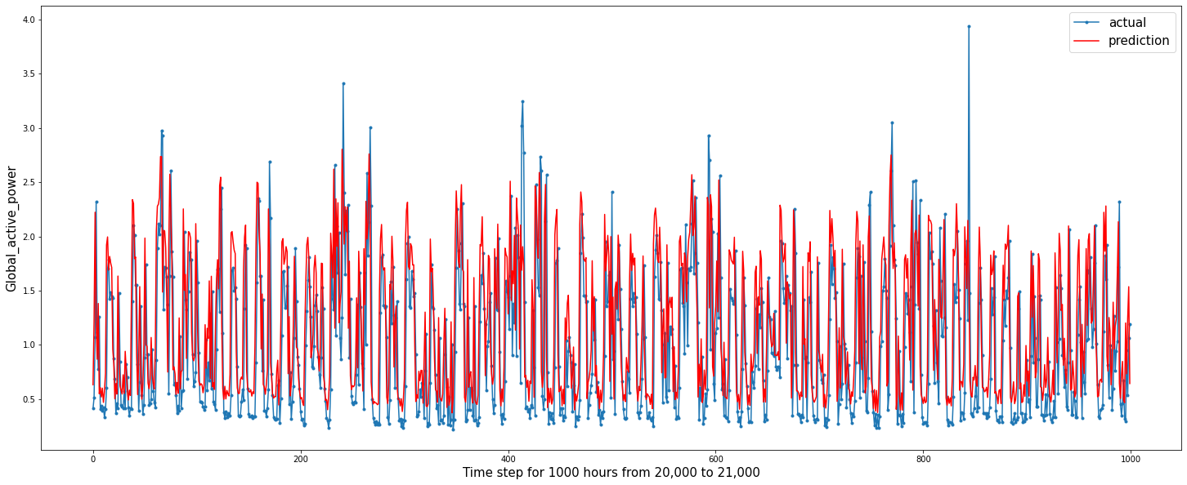
LSTM Model Data Preparation – Global Active Power
Prediction of 20,000 to 21,000 Dataset

Slide 45
LSTM Model Data Preparation and Fitting – Sub metering3

Slide 46
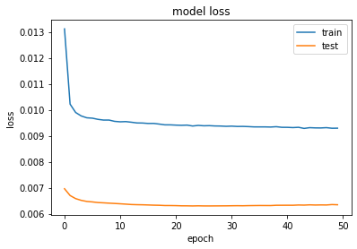
LSTM Model Data Preparation – Sub metering3
For Sub metering3, LSTM model looks like:-
100 neurons in the first visible layer
dropout 10%
1 neuron in the output layer for predicting Sub metering3
The input shape will be 1 time step with 7 features
The mean squared error loss function and the efficient adam version of stochastic gradient descent
The model will be fit for 50 training epochs with a batch size of 100.
In the final Output the training loss comes to be 0.93% and testing loss comes out to be 0.63%
Mean Absolute Error: 0.362
Mean Squared Error: 0.263
Test RMSE: 0.513

Slide 47
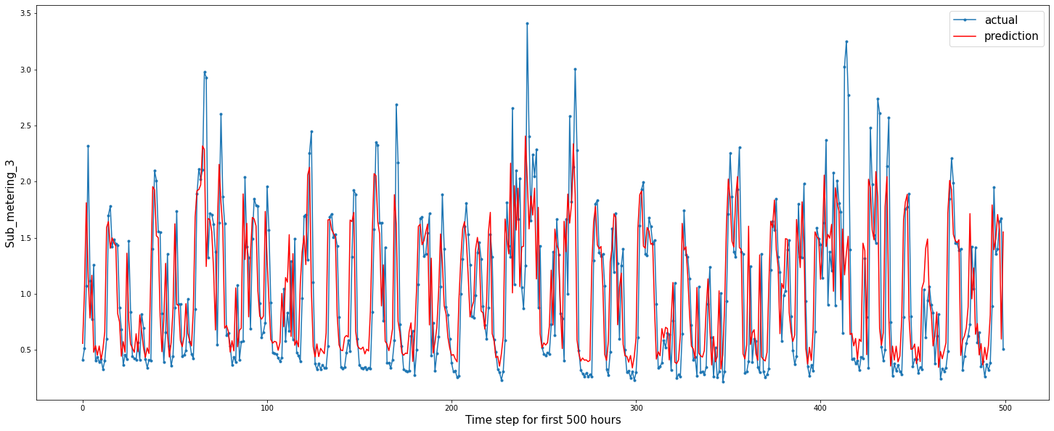
LSTM Model Data Preparation – Sub metering3
First 500 data prediction

Slide 48
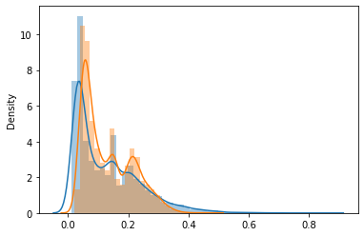
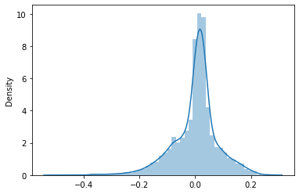
LSTM Model Data Preparation – Sub metering3
Actual and Predicted Distribution Distplot of difference of actual and predicted value
Difference of Variance = 0.004980459687564526

Slide 49
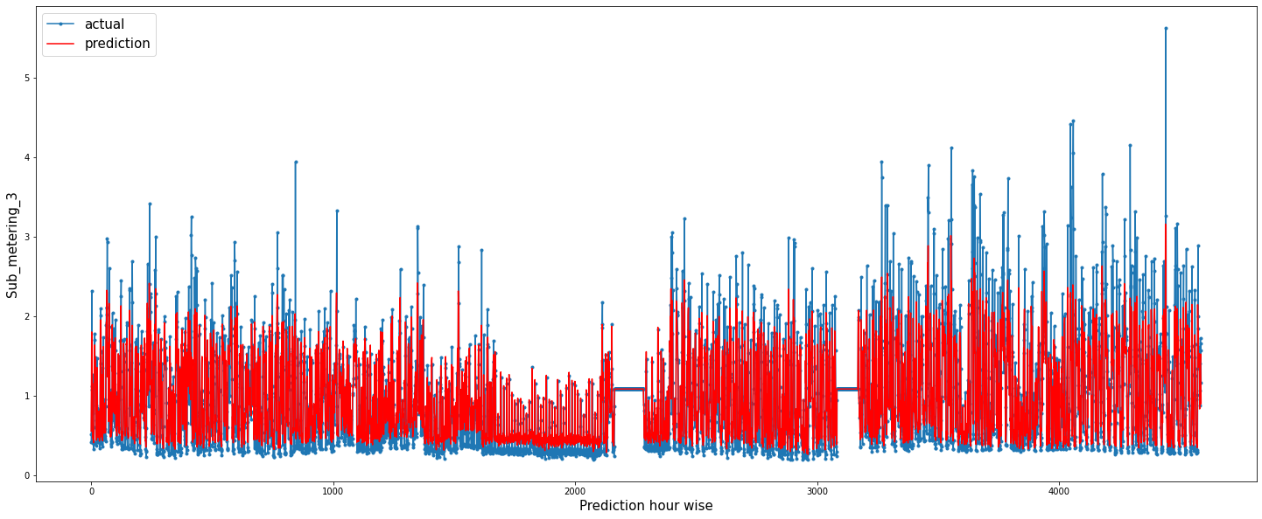
LSTM Model Data Preparation – Sub metering3
Prediction of Test Data

Slide 50
LSTM Model Data Preparation and Fitting – Global Reactive Power

Slide 51
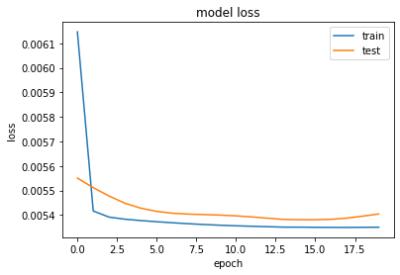
LSTM Model Data Preparation – Global Reactive Power
For Global Reactive Power, model looks like:-
100 neurons in the first visible layer
Dense layer of 30 neurons and 1 neuron in the output layer for predicting Global reactive power
The input shape will be 1 time step with 7 features
The mean squared error loss function and the efficient adam version of stochastic gradient descent
The model will be fit for 20 training epochs with a batch size of 100.
In the final Output the training loss comes to be 0.54% and testing loss comes out to be 0.55%
Mean Absolute Error: 0.043
Mean Squared Error: 0.003
Test RMSE: 0.057

Slide 52
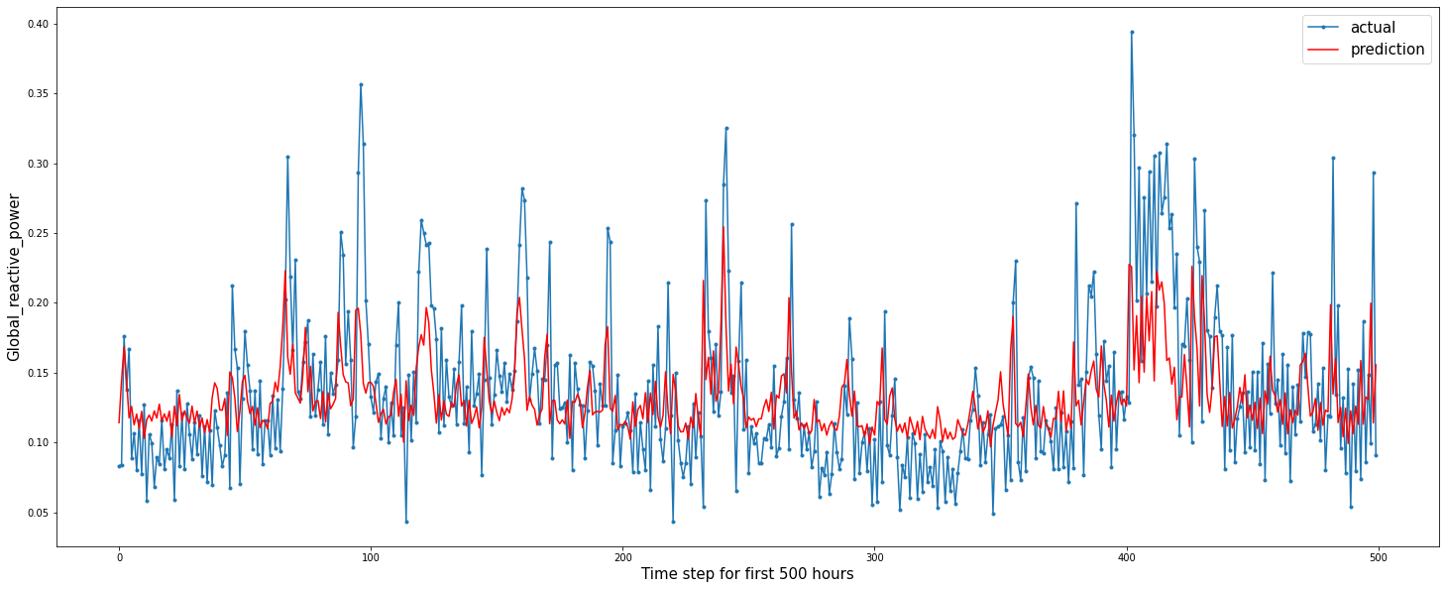
LSTM Model Data Preparation – Global Reactive Power
First 500 data prediction

Slide 53
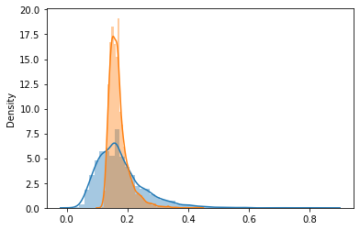
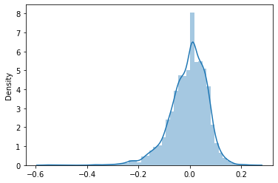
LSTM Model Data Preparation – Global Reactive Power
Actual and Predicted Distribution Distplot of difference of actual and predicted value
Difference of Variance = 0.005409543525522913

Slide 54
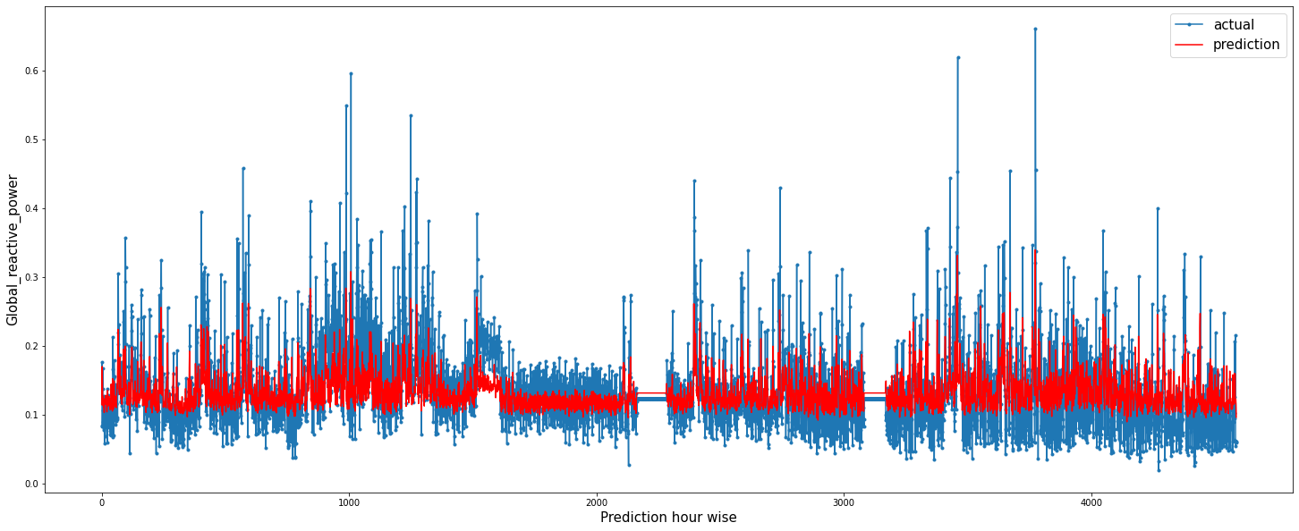
LSTM Model Data Preparation – Global Reactive Power
Prediction of Test Data

Slide 55
LSTM Model Data Preparation and Fitting
– Voltage

Slide 56
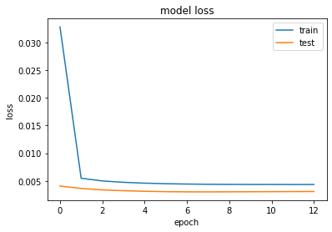
LSTM Model Data Preparation – Voltage
For Voltage, model looks like:-
100 neurons in the first visible layer
1 neuron in the output layer for predicting Voltage
The input shape will be 1 time step with 7 features
The mean squared error loss function and the efficient adam version of stochastic gradient descent
The model will be fit for 13 training epochs with a batch size of 100.
In the final Output the training loss comes to be 0.43% and testing loss comes out to be 0.31%
Mean Absolute Error: 1.099
Mean Squared Error: 2.091
Test RMSE: 1.446

Slide 57
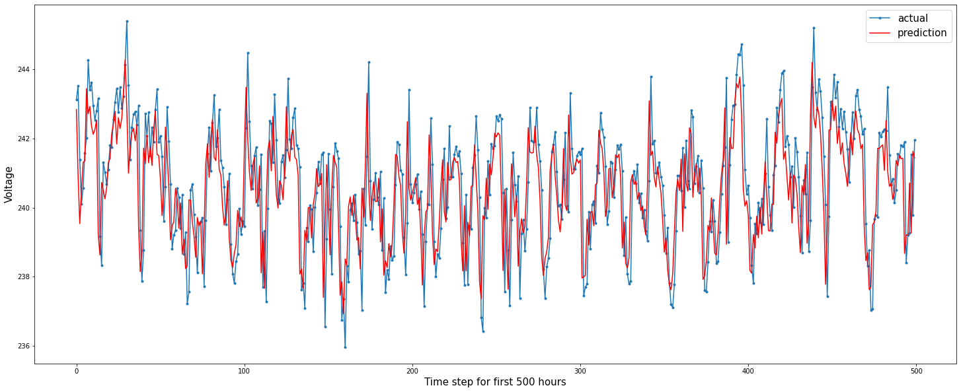
LSTM Model Data Preparation – Voltage
First 500 data prediction

Slide 58
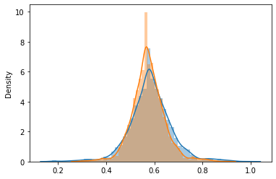
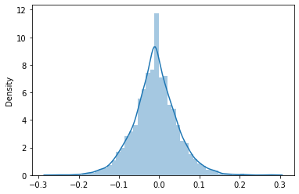
LSTM Model Data Preparation – Voltage
Actual and Predicted Distribution Distplot of difference of actual and predicted value
Difference of Variance = 0.003122210517629477

Slide 59
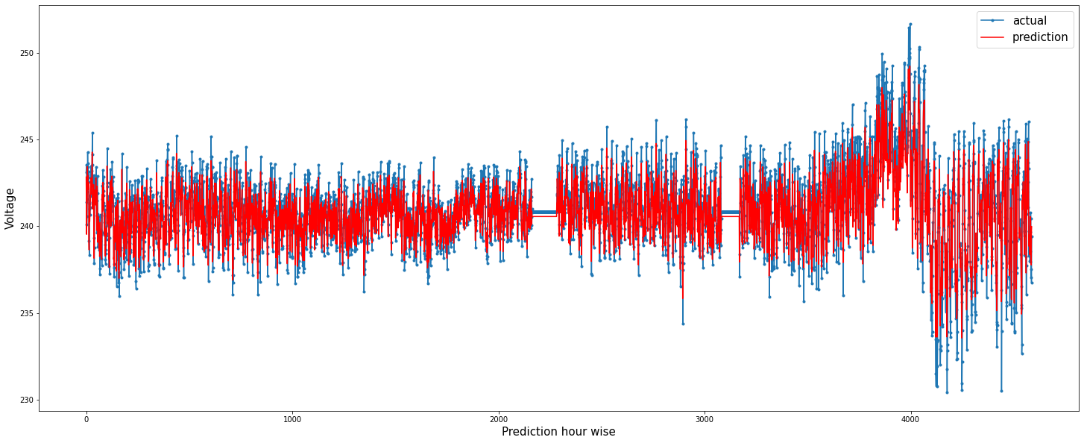
LSTM Model Data Preparation – Voltage
Prediction of Test Data

Slide 60
LSTM Model Data Preparation and Fitting
– Global Intensity

Slide 61
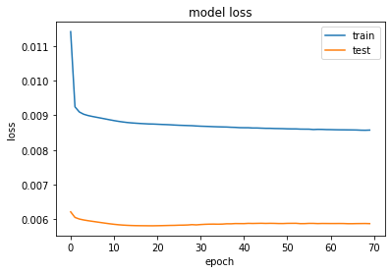
LSTM Model Data Preparation – Global Intensity
The Model for Global Intensity looks like:-
100 neurons in the first visible layer
30 neurons on the Dense Layer
1 neuron in the output layer for predicting Global Intensity
The input shape will be 1 time step with 7 features
The mean squared error loss function and the efficient adam version of stochastic gradient descent
The model will be fit for 70 training epochs with a batch size of 100.
In the final Output the training loss comes to be 0.86% and testing loss comes out to be 0.59%
Mean Absolute Error: 1.492
Mean Squared Error: 4.565
Test RMSE: 2.137

Slide 62
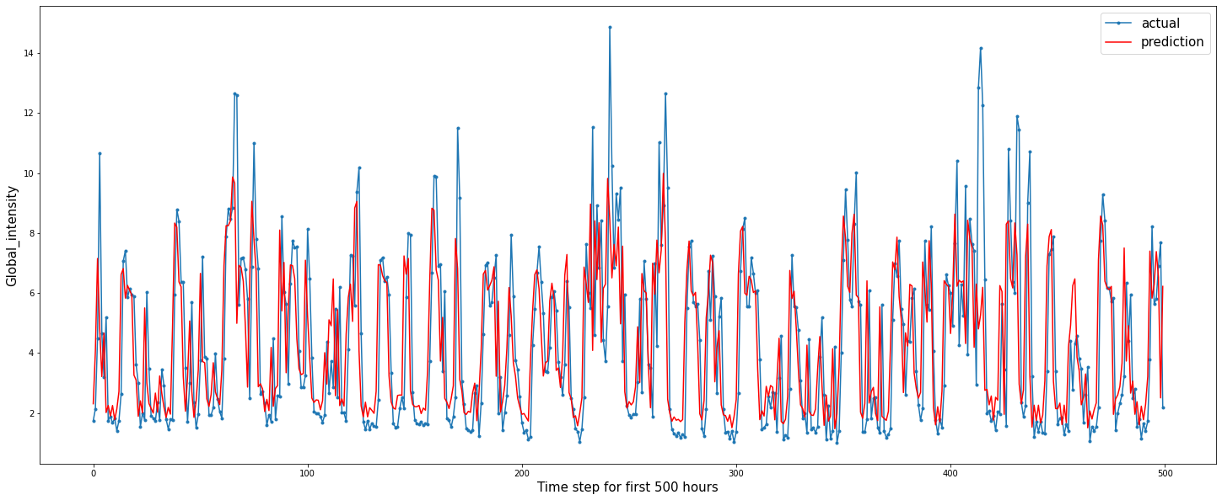
LSTM Model Data Preparation – Global Intensity
First 500 data prediction

Slide 63
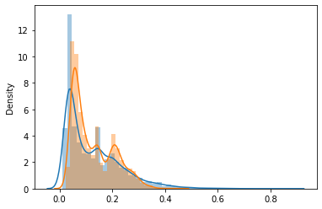
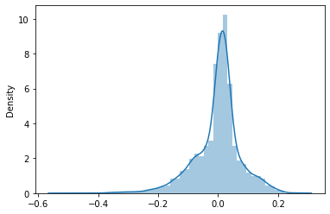
LSTM Model Data Preparation – Global Intensity
Actual and Predicted Distribution Distplot of difference of actual and predicted value
Difference of Variance = 0.004644270721047748

Slide 64
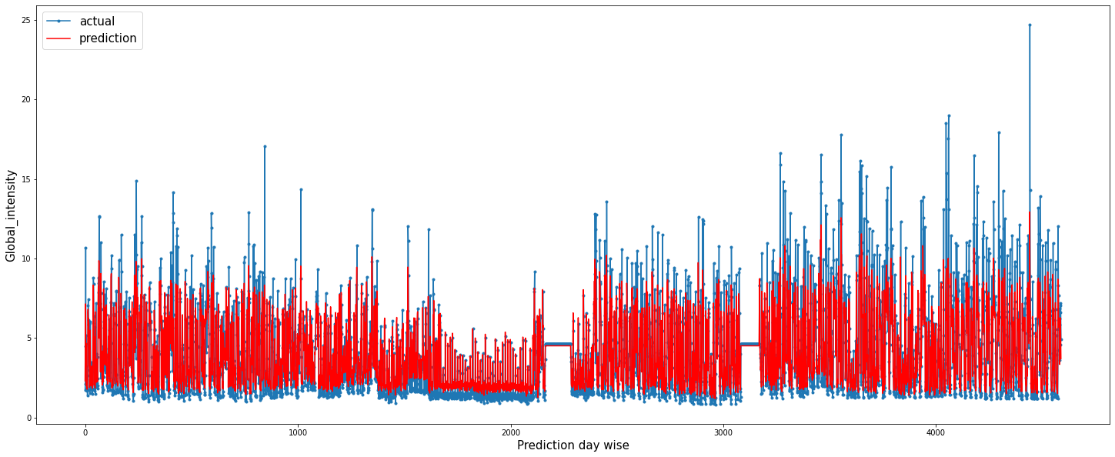
LSTM Model Data Preparation – Global Intensity
Prediction of Test Data

Slide 65
LSTM Model Data Preparation and Fitting
– Sub metering1

Slide 66
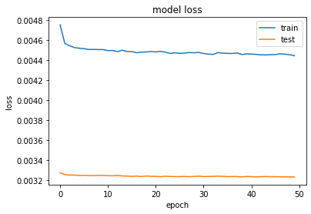
LSTM Model Data Preparation – Sub metering1
The Model for Sub Metering1 looks like:-
200 neurons in the first visible layer
Dropout of 0.5 %
1 neuron in the output layer for predicting Sub metering1
The input shape will be 1 time step with 7 features
The mean squared error loss function and the efficient adam version of stochastic gradient descent
The model will be fit for 50 training epochs with a batch size of 100.
In the final Output the training loss comes to be 0.44% and testing loss comes out to be 0.32%
Mean Absolute Error: 1.168
Mean Squared Error: 7.563
Test RMSE: 2.750

Slide 67

LSTM Model Data Preparation – Sub metering1
First 500 data prediction

Slide 68


LSTM Model Data Preparation – Sub metering1
Actual and Predicted Distribution Distplot of difference of actual and predicted value
Difference of Variance = 0.00323070547741026

Slide 69

LSTM Model Data Preparation – Sub metering1
Prediction of Test Data

Slide 70
LSTM Model Data Preparation and Fitting
– Sub metering2

Slide 71

LSTM Model Data Preparation – Sub metering2
The Model for Sub metering2 looks like:-
100 neurons in the first visible layer
Dropout of 0.5 %
1 neuron in the output layer for predicting Sub_metering2
The input shape will be 1 time step with 7 features
The mean squared error loss function and the efficient RMSprop version of stochastic gradient descent
The model will be fit for 50 training epochs with a batch size of 100.
In the final Output the training loss comes to be 0.67% and testing loss comes out to be 0.31%
Mean Absolute Error: 1.023
Mean Squared Error: 6.770
Test RMSE: 2.602

Slide 72

LSTM Model Data Preparation – Sub metering2
First 500 data prediction

Slide 73


LSTM Model Data Preparation – Sub metering2
Actual and Predicted Distribution Distplot of difference of actual and predicted value
Difference of Variance = 0.003075468948807031

Slide 74

LSTM Model Data Preparation – Sub metering2
Prediction of Test Data

Slide 75
Implementation Using ELEPHAS

Slide 76
Implementation Using ELEPHAS
In this report we have used PySpark, Keras, and Elephas python libraries to build an end-to-end deep learning pipeline that runs on Spark. Spark is an open-source distributed analytics engine that can process large amounts of data with tremendous speed. PySpark is simply the python API for Spark that allows you to use an easy programming language, like python, and leverage the power of Apache Spark.
Elephas brings deep learning with Keras to Spark. Elephas intends to keep the simplicity and high usability of Keras, thereby allowing for fast prototyping of distributed models, which can be run on massive data sets.
Using setAppName() and also set how many workers you want. We are just running this locally and we have set it to a possible 8 workers or cores. For this keras Deep Learning Model just install elephas from PyPI with, Spark will be installed through pyspark for you.

Slide 77
Implementation Using ELEPHAS
We did a basic Spark integration using ELEPHAS by creating a Spark Context.
Then defined the Keras model which is supposed to be integrated.
The TrainX and TrainY has been converted in a simple RDD and then it has been feed into the created Spark Model.
Finally the final evaluation takes through percentage of test data loss.

Slide 78




Global Active Power :
Global Re-active Power :
Voltage :
Global Intensity :
Sub metering1 :
Sub metering2 :
Sub metering3 :

Slide 79
CONCLUSION

Slide 80
Conclusion
In this Report, we practice to use the LSTM to fit and predict household electric power consumption. Consideration of the amount of input data is important to balance model accuracy and computation cost. For different attributes, different parameter has been used.
The database can be used 30000 for fitting purposes and the rest has been used to validate the model. Also using the Elephas library for Big Data, has made it easier and faster to train the model in a significant manner.
Future Work:-
Various other different Model evaluation such for regression analysis can be useful this project.
Predictive Attribute | Minimum Error
Global Active Power | MSE : 0.260
Global Reactive Power | MSE : 0.003
Voltage | MAE : 1.099
Global Intensity | MAE : 1.492
Sub_meterring1 | MAE : 1.168
Sub_metering2 | MAE : 1.023
Sub_metering3 | MSE : 0.263

Slide 81
Thank You !!

